Slide 1
Updates
2026-11-06

Slide 2
EMaGer assembly
One done, one almost done

Slide 3
PCB Orders
Almost arrived, if not already
Assembly and unit tests will be next
Will also need to know how to ship my flex from Laval University

Slide 4
Protocols
Sterilization: On hold
Electrode installation on subject: Barely started
  Only localization of electrode 0

Slide 5
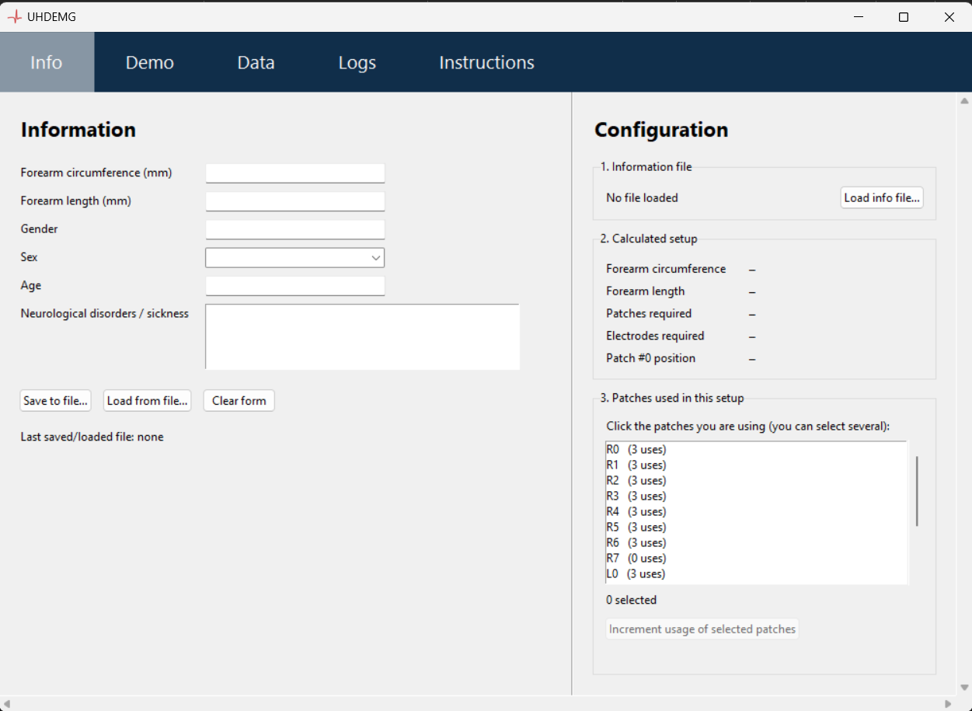
Data Acquisition App
Started my data acquisition app

Slide 6
Data Acquisition App
What it can do:
  Generate config file from one subject
  Keep track of electrode patches usage
  Connect to FPGA
  Collect data (it simulates the INTAN)
What needs to be implemented
  Saving data
  Visualization
  Calibration
  Others

Slide 7
Data Acquisition App
Interesting things to add
  LibEMG
    Visualisation tools (Live graphs and heatmap)
    Analysis of EMG data (Maybe)
  Open Ephys
    Acquisition of data (will need to be tested first)

Slide 8
Next steps
Finish assembly of EMaGer
Start assembly of my boards (and ship my flexs)
  Unit tests to prepare and do
ISCAS paper review
Backburner
  Protocols
  Data acquisition app

